Slide 1
ENSE 470, Milestone 2
Tiger Vikings
Samuel Iregbu,
Christian John,
Jay Denesik,
Uys Kriek
January 25th, 2018

Slide 2
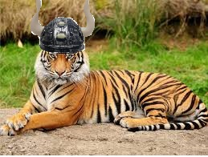
Team Introductions:
Tiger Vikings
Team members: Samuel Iregbu, Christian John, Jay Denesik, Uys Kriek

Slide 3
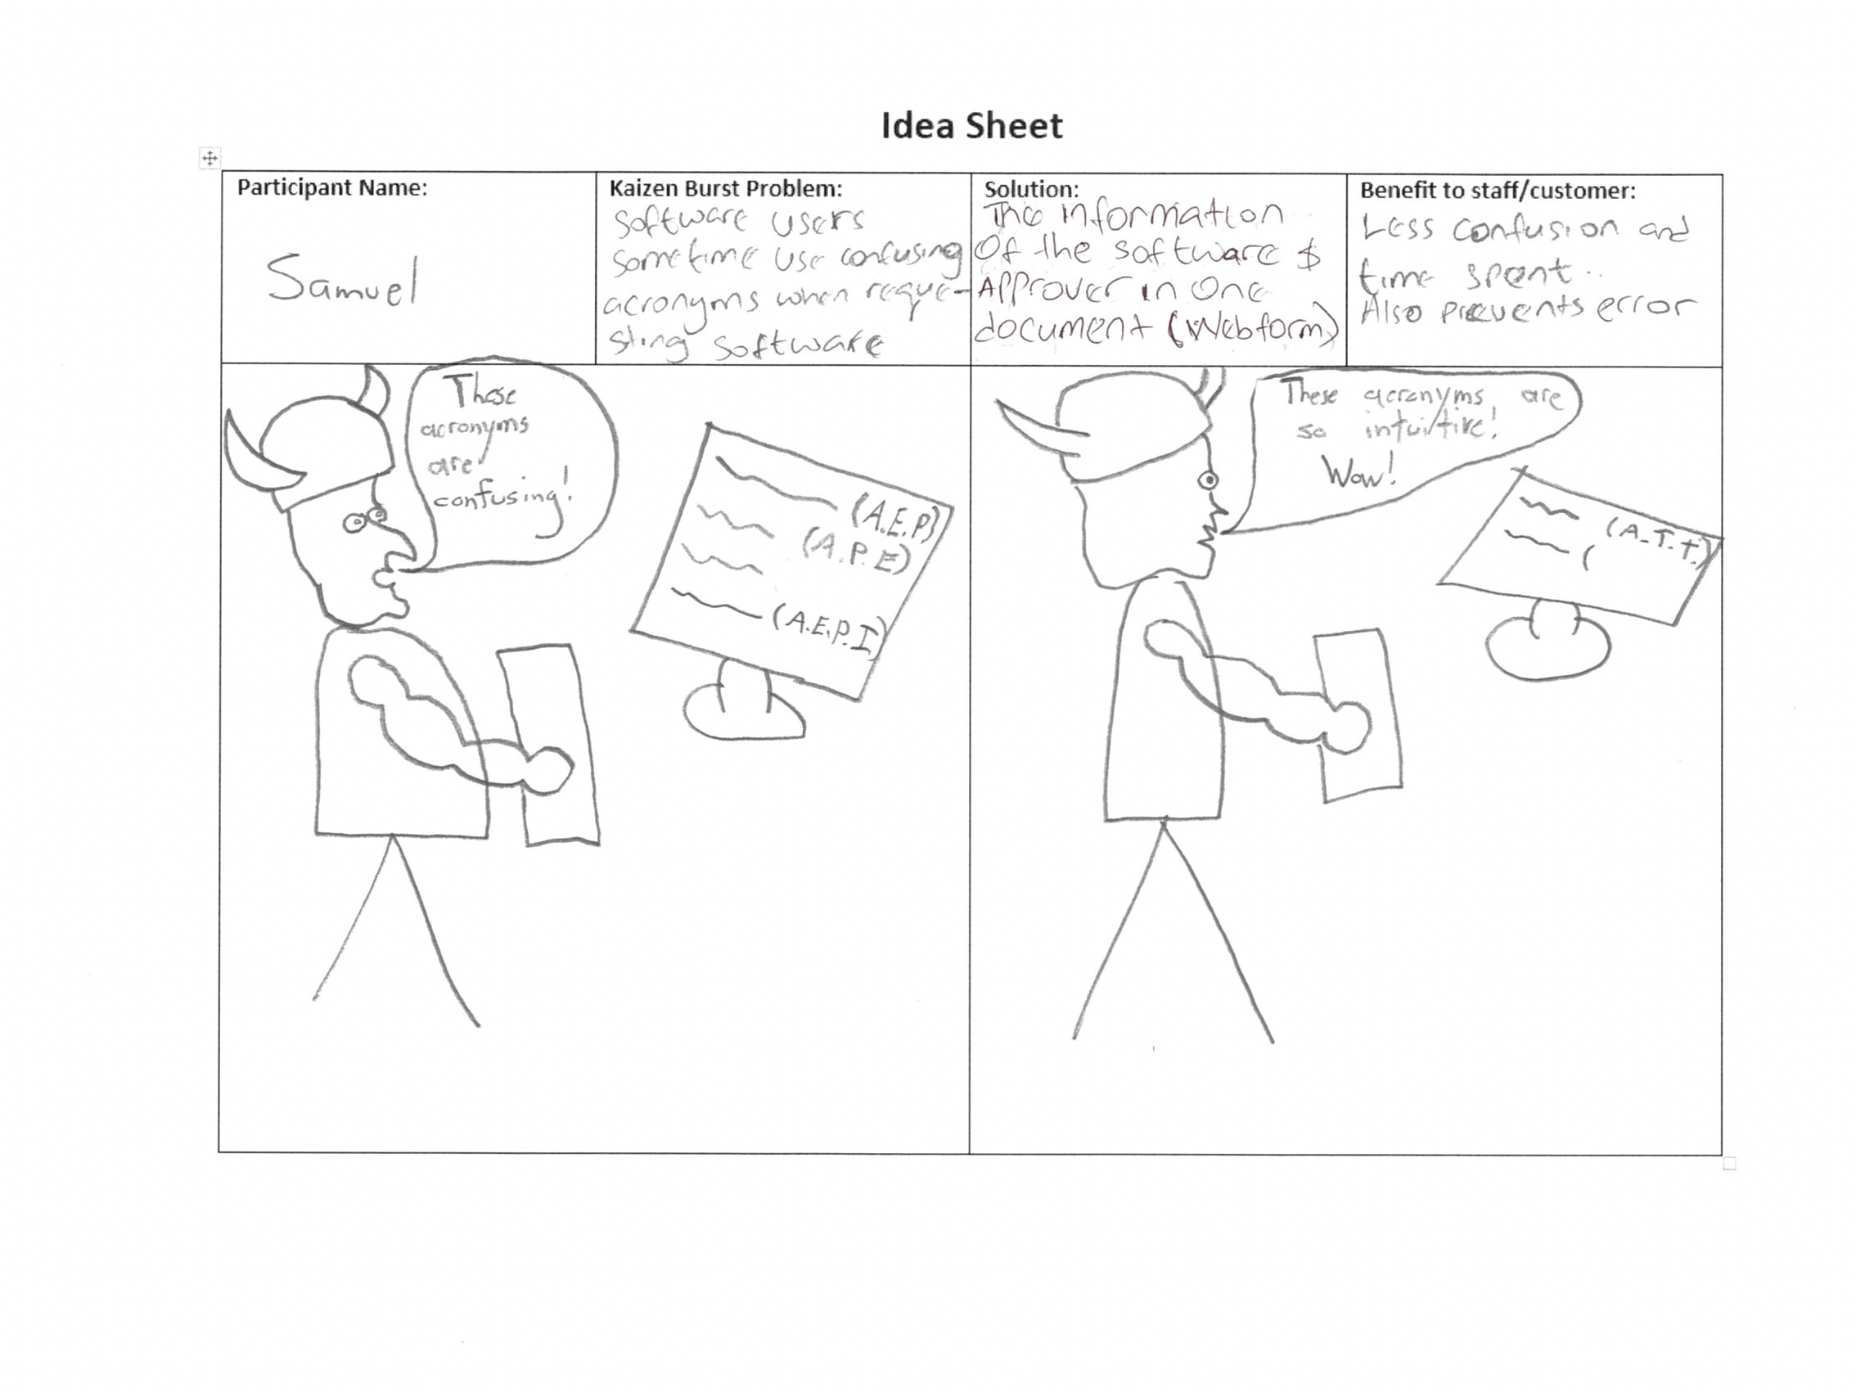
Software users sometimes use confusing acronyms when requiring software

Slide 4
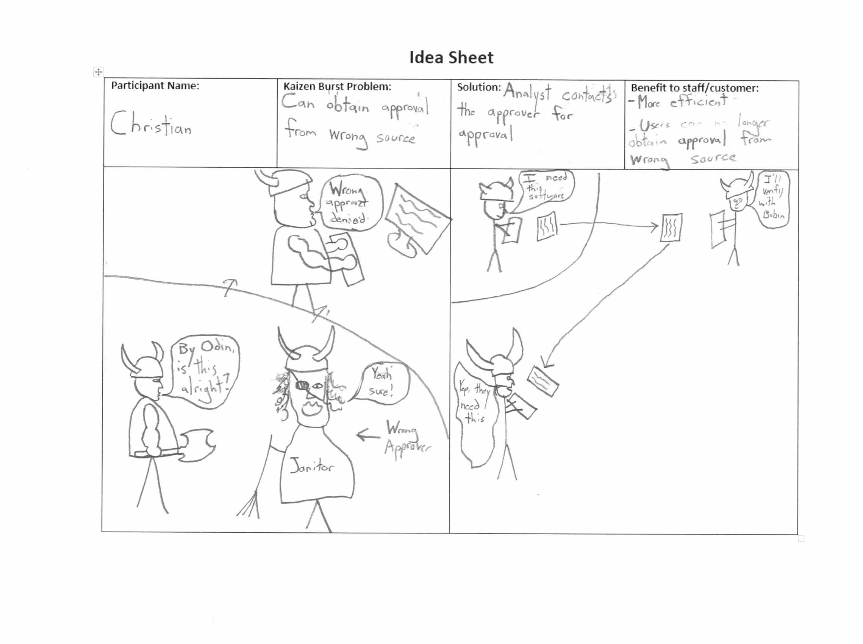
Can obtain approval from wrong source

Slide 5
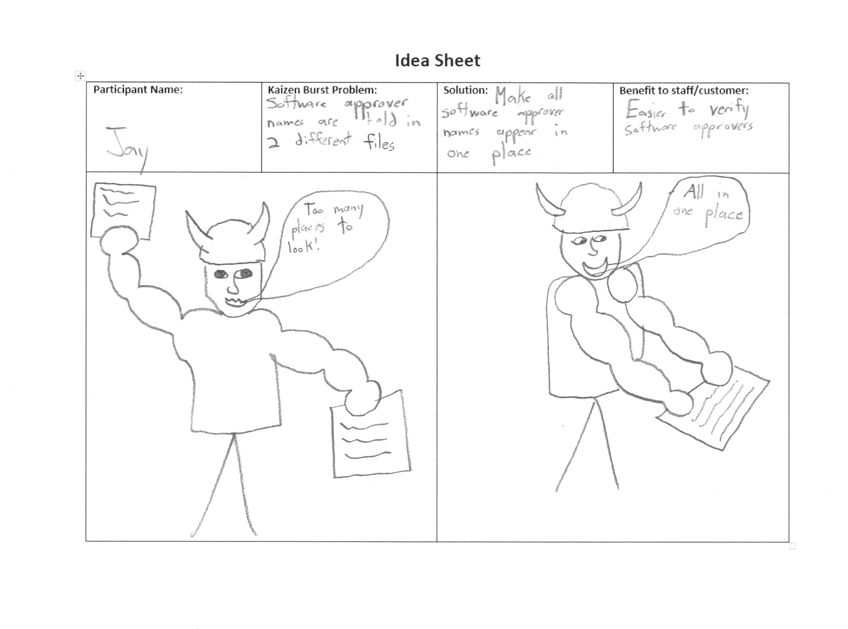
Software approver names are held in two different files

Slide 6
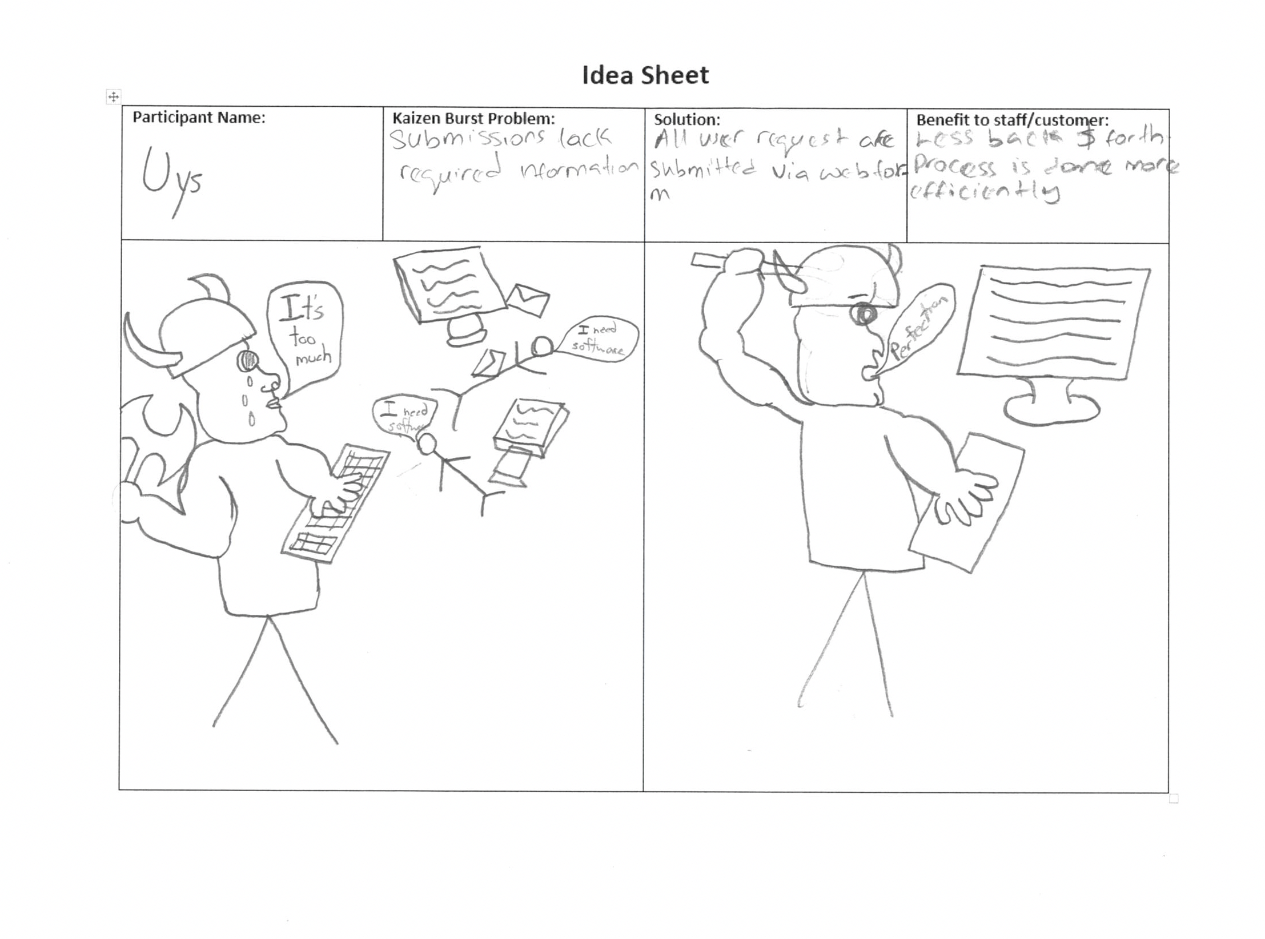
Submissions lack required information

Slide 7
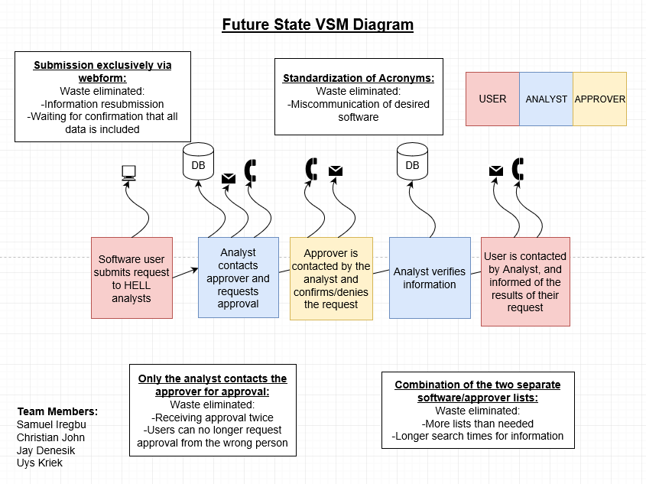

Slide 8
Group Reflection:
How did you feel about this milestone? What did you like about it? What did you dislike?
This milestone helped in the planing out of future solution for the problems. We didn’t really dislike anything.
What did you learn about yourself as you collaborated and worked through this milestone?
We learned how to work as a team. We also learned that we prefer to create our diagrams via pen and paper, rather than using software.
How will you use what you have learned going forward?
We will be able to make use of idea sheets to properly outline solutions to our kaizen plans.
What “stuff & things” related to this milestone would you want help with?
Nothing in particular

